Slide 1

JAVA 8
At First Glance

Slide 2
Agenda
New Terms in Java language
Lambda Expression
Functional Interface
Interface’s default and Static Methods
Method References
New Features in Java libraries
Stream API
Optional
Date/Time API

Slide 3
Lambda Expression
What is Lambda Expression?

Slide 4
Lambda Expression
Unnamed block of code (or an unnamed function) with a list of formal parameters and a body.
Concise
Anonymous
Function
Passed around

Slide 5
Lambda Expression
Why should we care about Lambda Expression?

Slide 6
Lambda Expression
Example:
Comparator<Person> byAge = new Comparator<Person>(){
public int compare(Person p1, Person p2){
return p1.getAge().compareTo(p2.getAge());
}
};
Notes:
The code is quite not elegant and not easy to read.
Anonymous classes use a bulky syntax. Lambda expressions
use a very concise syntax to achieve the same result.

Slide 7
Lambda Expression
Example 1: with lambda
Comparator<Person> byAge =
(Person p1, Person p2) -> p1.getAge().compareTo(p2.getAge());
Example 2: with lambda
testButton.addActionListener(e -> System.out.println(“Hello Lambda"));

Slide 8
Lambda Expression
Lambda Syntax

Slide 9
Lambda Expression
Arrow
(Person p1, Person p2) -> p1.getAge().compareTo(p2.getAge());
Lambda parameters
Lambda body
The basic syntax of a lambda is either
(parameters) -> expression
or
(parameters) -> { statements; }
Notes:
The body of a lambda expression is a block of code enclosed in braces. Like
a method's body, the body of a lambda expression may declare local variables; use statements including break,
continue, and return; throw exceptions, etc.

Slide 10
Lambda Expression
Lambda does not have:
Name
Return type
Throws clause
Type parameters
Notes:
A lambda expression does not have a name.
A lambda expression does not have a throws clause. It is inferred from the context of its use
and its body.
A lambda expression cannot declare type parameters. That is, a lambda expression cannot be generic
A lambda expression does not have a explicit return type. It is auto recognized by the compiler from the context of its use and from its body.

Slide 11
Lambda Expression
Examples:
(String s) -> s.length()
(Person p) -> p.getAge() > 20
() -> 92
(int x, int y) -> x + y
(int x, int y) -> {
System.out.println(“Result:”);
System.out.println(x + y);
}

Slide 12
Lambda Expression
Not allow:
public void printNumber(int x) {
int y = 2;
Runnable r = () -> {
x++;//compile error
System.out.println(“Total is:” + (x+y))
};
}
Variable scope:
public void printNumber(int x) {
int y = 2;
Runnable r = () -> System.out.println(“Total is:” + (x+y));
new Thread(r).start();
}
Variable scope:
public void printNumber(int x) {
int y = 2;
Runnable r = () ->{System.out.println(“Total is:” + (x+y));
System.out.println(this.toString());};
new Thread(r).start();
}
Free variable: not define in lambda parameters.
Notes:
Accessing outer scope variables from lambda expressions is very similar to anonymous objects. You can access final variables from the local outer scope as well as instance fields and static variables

Slide 13
Lambda Expression
Where should we use Lambda?

Slide 14
Lambda Expression
Example:
public void main(String[] args){
(int x, int y) -> System.out.println(x + y);
}
Comparator:
Comparator<Person> byAge =
(Person p1, Person p2) -> p1.getAge().compareTo(p2.getAge());
Collections.sort(personList, byAge);
Listener:
ActionListener listener = e -> System.out.println(“Hello Lambda")
testButton.addActionListener(listener );

Slide 15
Lambda Expression
Runnable:
// Anonymous class
Runnable r1 = new Runnable(){
@Override
public void run(){
System.out.println("Hello world one!");
}
};
// Lambda Runnable
Runnable r2 = () -> System.out.println("Hello world two!");

Slide 16
Lambda Expression
Iterator:
List<String> features = Arrays.asList("Lambdas", "Default Method", "Stream API", "Date and Time API");
//Prior to Java 8 :
for (String feature : features) {
System.out.println(feature);
}
//In Java 8:
Consumer<String> con = n -> System.out.println(n)
features.forEach(con);
Notes:
So where exactly can you use lambdas? You can use a lambda expression in the context of a
functional interface. Don’t worry if this sounds abstract; we now explain in detail what this means and what a functional interface
is.

Slide 17
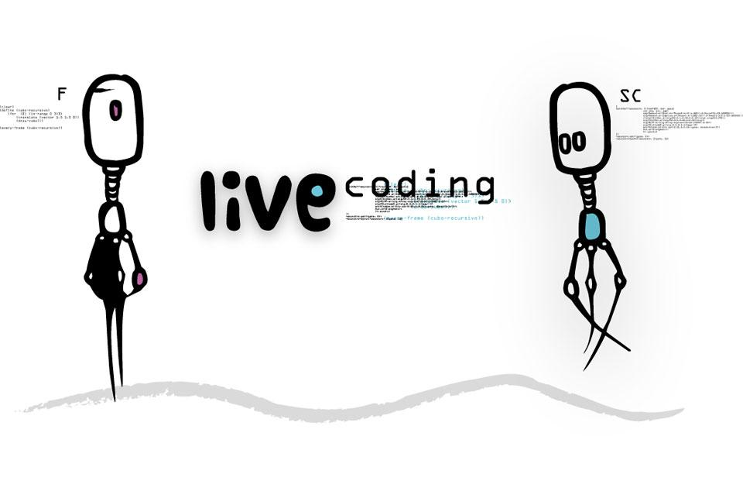
Demonstration

Slide 18
Functional Interface
Add text here...
What is functional interface?

Slide 19
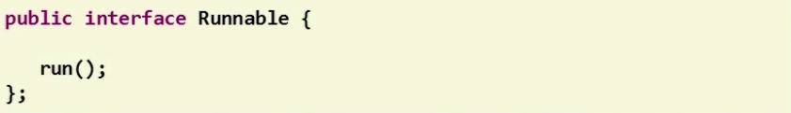
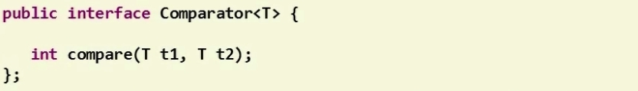
Functional Interface
Add text here...
New term of Java 8
A functional interface is an interface with only one abstract method.
Notes:
Functional Interface is a new term of Java 8
The functional interface is an normal interface with only one abstract method.
Take a look at the example here, the well-known Runnable and Comparator interface are now become functional interface, so what we can see here that the term of functional interface is new but all the interfaces back from previous Java versions are becoming functional interface without any needed of modification.

Slide 20
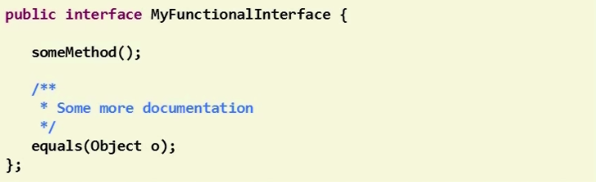
Functional Interface
Add text here...
Methods from the Object class don’t count.
Notes:
When we count the abstract method from an interface to check if it’s functional interface or not. The methods from Object class don’t count.
Why some methods of the Object class sometimes are added to an interface? But most of the time and this is the reason because someone would like to redeclared methods from Object class in the interface in order to extend comments from Object’s class in order to give some special semantic and to add javadoc that might be different from Object class.
http://grepcode.com/file_/repository.grepcode.com/java/root/jdk/openjdk/6-b14/java/util/Comparator.java/?v=source

Slide 21
Functional Interface
Add text here...
Annotation in Functional Interface
Notes:
By the default, the compiler of Java will automatically check if interface is a functional interface or not.
But for convenience, the functional interface can be annotated inside the code.

Slide 22
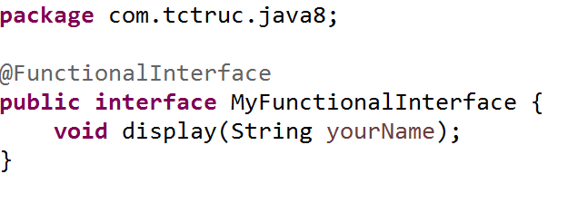
Functional Interface
Add text here...
A functional interface can be annotated.
It’s optional.
Notes:
It can be annotated by adding @FunctionalInterface on the top of the interface like the example below.
By doing so, the IDE will help you to detect if it is a functional interface before compiler do its job.

Slide 23
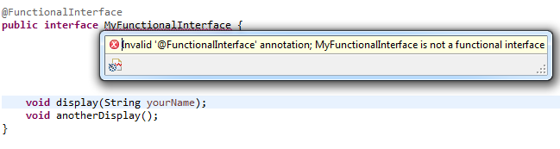
Functional Interface
Add text here...
Show compile error when define more than one abstract method.
Notes:
In this example, I declared another abstract method in the functional interface and as you can see, with the annotation, the IDE will check and show an error message that this interface is not a functional interface. So you can immediately notice and correct the problem.

Slide 24
Functional Interface
Add text here...
Functional Interfaces
Toolbox
Notes:
With the new term of functional interface defined in java 8.
It also includes a brand new sets of functional interfaces.

Slide 25
Functional Interface
Add text here...
Brand new java.util.function package.
Rich set of functional interfaces.
4 categories:
Supplier
Consumer
Predicate
Function
Notes:
All these functional interfaces are defined in new package named java.util.function.
It contains around 43 interfaces and grouped into 4 categories as I listed below: Supplier, consumer, predicate, function.
You will see and use it a lot when you working with Java 8 and lambda expression.
In the scope of this presentation I will not go and explain for every interfaces. Instead, I will pick one of them to give you an example.

Slide 26
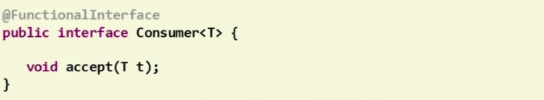
Consumer Interface
Add text here...
Accept an object and return nothing.
Can be implemented by lambda expression.

Slide 27
Demonstration

Slide 28
Interface Default and Static Methods
Add text here...
Interface Default and Static Methods

Slide 29
Interface Default and Static Methods
Extends interface declarations with two new concepts:
- Default methods
- Static methods
Advantages:
No longer need to provide your own companion utility classes. Instead, you can place static methods in the appropriate interfaces
java.util.Collections
java.util.Collection
static <T> Collection<T> synchronizedCollection(Collection<T> c)
Adding methods to an interface without breaking the existing implementation

Slide 30
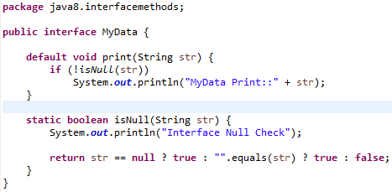
Interface Default and Static Methods
Syntax
[modifier] default | static returnType nameOfMethod (Parameter List) { // method body }
Notes:
Classes implement interface that contains a default method, they can perform following:
- Not override the default method and will inherit the default method - Override the default method similar to other methods we override in subclass - Redeclare default method as abstract, which force subclass to override it

Slide 31
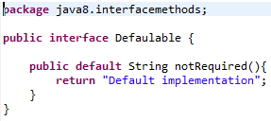

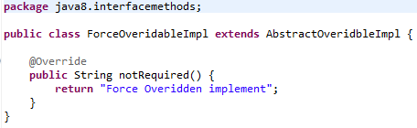
Default methods
Classes implement interface that contains a default method
Not override the default method and will inherit the default method
Override the default method similar to other methods we override in subclass
Redeclare default method as abstract, which force subclass to override it
Notes:
Classes implement interface that contains a default method, they can perform following:
- Not override the default method and will inherit the default method - Override the default method similar to other methods we override in subclass - Redeclare default method as abstract, which force subclass to override it

Slide 32
Default methods
Solve the conflict when the same method declare in interface or class
Method of Superclasses, if a superclass provides a concrete method.
If a superinterface provides a default method, and another interface supplies a method with the same name and parameter types (default or not), then you must overriding that method.

Slide 33

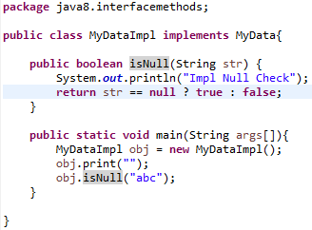
Static methods
Similar to default methods except that we can’t override them in the implementation classes

Slide 34
Demonstration

Slide 35
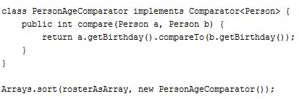
Method References
Method reference is an important feature related to lambda expressions. In order to that a method reference requires a target type context that consists of a compatible functional interface

Slide 36
Method References
There are four kinds of method references:
Reference to a static method
Reference to an instance method of a particular object
Reference to an instance method of an arbitrary object of a particular type
Reference to a constructor

Slide 37
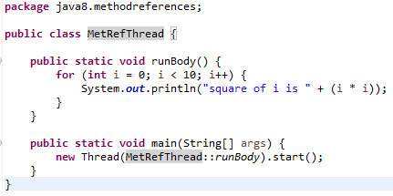
Method References
Reference to a static method
The syntax: ContainingClass::staticMethodName

Slide 38
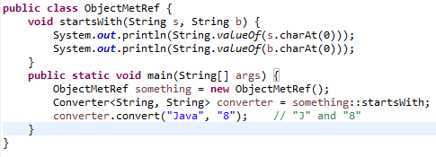
Method References
Reference to an instance method of a particular object
The syntax: containingObject::instanceMethodName

Slide 39
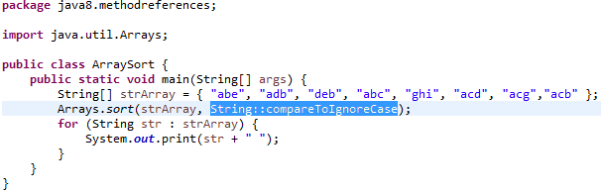
Method References
Reference to an instance method of an arbitrary object of a particular type
The syntax: ContainingType::methodName

Slide 40
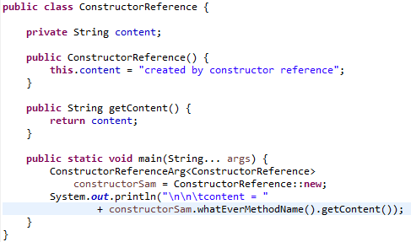

Method References
Reference to a constructor
The syntax: ClassName::new

Slide 41
Method References
Method references as Lambdas Expressions
Syntax | Example | As Lambda
ClassName::new | String::new | () -> new String()
Class::staticMethodName | String::valueOf | (s) -> String.valueOf(s)
object::instanceMethodName | x::toString | () -> "hello".toString()
Class::instanceMethodName | String::toString | (s) -> s.toString()

Slide 42
Stream
Add text here...
Stream API
Notes:
Now we know about Lambda Expression and FunctionInterface
How its can be used in Stream
Before talking about Stream, let me show you some example code

Slide 43
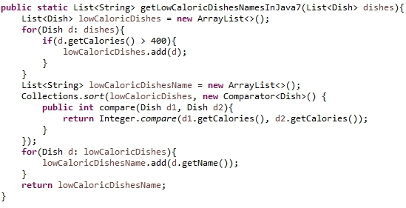
Stream
Add text here...
Old Java:
Notes:
The implementation code without Stream

Slide 44
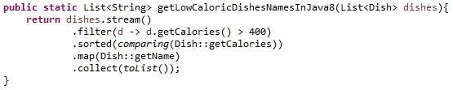
Stream
Add text here...
Java 8:
Notes:
The implementation code with Stream
It looks simple and clean
Build the stream from list
Transform stream by filter, map
Convert the result from stream to another list by collect

Slide 45
Stream
Add text here...
What is a Stream?

Slide 46
Stream
Add text here...
Not store data
Designed for processing data
Not reusable
Can easily be outputted as arrays or lists
Notes:
Need to create stream from a collection everytime you want to use it
Finish processing the

Slide 47
Stream - How to use
Add text here...
1. Build a stream
2. Transform stream
3. Collect result

Slide 48
Stream - build streams
Add text here...
Build streams from collections
List<Dish> dishes = new ArrayList<Dish>();
....(add some Dishes)....
Stream<Dish> stream = dishes.stream();

Slide 49
Stream - build streams
Add text here...
Build streams from arrays
Integer[] integers =
{1, 2, 3, 4, 5, 6, 7, 8, 9};
Stream<Integer> stream = Stream.of(integers);

Slide 50
Stream - Operations
Add text here...
Intermediate operations (return Stream)
filter()
map()
sorted()
….
Notes:
Intermediate operations return the stream itself so you can chain multiple method calls in a row. Let’s learn important ones.

Slide 51
Stream - filter()
Add text here...
// get even numbers
Stream<Integer> evenNumbers = stream
.filter(i -> i%2 == 0);
// Now evenNumbers have {2, 4, 6, 8}
Notes:
Intermediate operations return the stream itself so you can chain multiple method calls in a row. Let’s learn important ones.

Slide 52
Stream - Operations
Add text here...
Terminal operations
forEach()
collect()
match()
….
Notes:
Terminal operations return a result of a certain type instead of again a Stream.

Slide 53
Stream - forEach()
Add text here...
// get even numbers
evenNumbers.forEach(i -> System.out.println(i));
/* Console output
* 2
* 4
* 6
* 8
*/
Notes:
Intermediate operations return the stream itself so you can chain multiple method calls in a row. Let’s learn important ones.

Slide 54
Stream - Converting to collections
Add text here...
Converting stream to list
List<Integer> numbers = evenNumbers.collect(Collectors.toList());
Converting stream to array
Integer[] numbers = evenNumbers.toArray(Integer[]::new);
Notes:
Intermediate operations return the stream itself so you can chain multiple method calls in a row. Let’s learn important ones.

Slide 55
Optional Class
Provide a type-level solution for representing optional values instead of using null references
java.util.Optional
if(computer != null){
Soundcard soundcard = computer.getSoundcard();
if(soundcard != null){
USB usb = soundcard.getUSB();
if(usb != null){
version = usb.getVersion();
}
}
}
computer.flatMap(Computer::getSoundcard)
.flatMap(Soundcard::getUSB)
.map(USB::getVersion)
.orElse("UNKNOWN");

Slide 56
Demonstration

Slide 57
Date / Time
Add text here...
What’s new in Date/Time?

Slide 58
Date / Time
Add text here...
Why do we need a new Date/Time API?
Objects are not immutable
Naming
Months are zero-based
Notes:
statefull
Date is not a date, but a timestamp, Calendar is mix of dates and times…
have to work with Joda API. But there still have problem with the performance…
this new API is base on Joda and was implemented by joda team

Slide 59
Date / Time
Add text here...
LocalDate
A LocalDate is a date, with a year, month, and day of the month
LocalDate today = LocalDate.now();
LocalDate christmas = LocalDate.of(2015, 12, 25);

Slide 60
Date / Time
Add text here...
Java 7:
Calendar c = Calendar.getInstance();
c.add(Calendar.DATE, 1);
Date dt = c.getTime();
Java 8:
LocalDate tomorrow = LocalDate.now().plusDay(1);

Slide 61
Date / Time
Add text here...
Temporal adjuster
LocalDate nextPayDay = LocalDate.now() .with(TemporalAdjusters.lastDayOfMonth());

Slide 62
Date / Time
Add text here...
Create your own adjuster
TemporalAdjuster NEXT_WORKDAY = w -> {
LocalDate result = (LocalDate) w;
do {
result = result.plusDays(1);
} while (result.getDayOfWeek().getValue() >= 6);
return result;
};
LocalDate backToWork = today.with(NEXT_WORKDAY);

Slide 63

For further questions, send to us: hcmc-vision@axonactive.vn

Slide 64
References
Add text here...
Java Platform Standard Edition 8 Documentation, (http://docs.oracle.com/javase/8/docs/)
Java 8 In Action, Raoul-Gabriel Urma, Mario Fusco, and Alan Mycroft.
Beginning Java 8 Language Features, Kishori Sharan.
What’s new in Java 8 - Pluralsight

Slide 65

The End
Add text here...

